Slide 1
CS50 Lab 8 Andrew Holmes

Slide 2
Today’s Logistics
HTML/CSS recap
HTML/CSS exercise
JavaScript review
Lab – Trivia!

Slide 3
HTML/CSS
Making pretty websites!

Slide 4
HTML basics
<html>
<head>
<title>Document</title>
</head>
<body>
</body>
</html>
The basic layout of an HTML document. Things to remember:
index.html standard
metadata goes in head tags (not displayed content)
Need to use <link> to use a CSS stylesheet

Slide 5
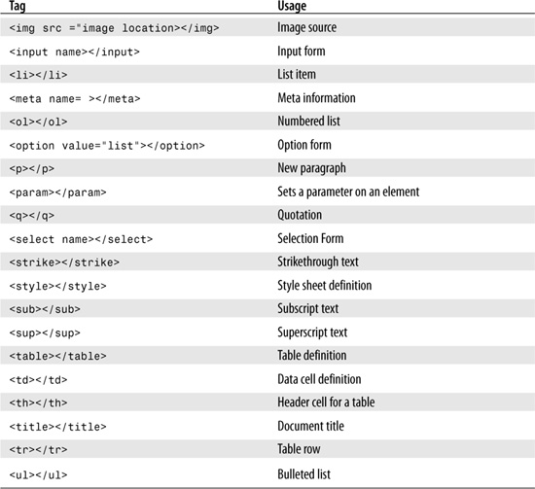
HTML tags
Internet is your friend this week!
There are so many HTML/CSS/JS options I can’t cover even a fraction.

Slide 6
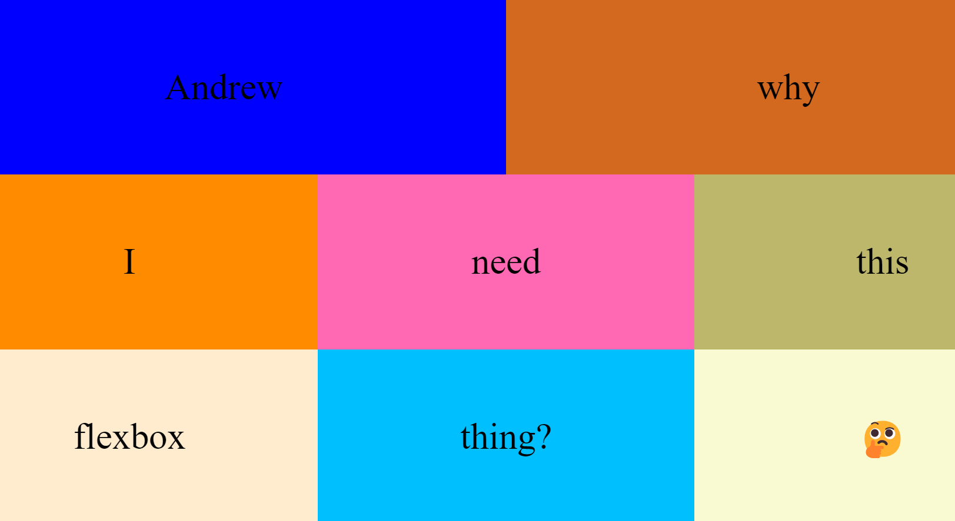
The <div> tag
The <div> tag is one of the most useful tags in HTML. It is essentially just a container that you can put anything in. It allows us to group content and apply styles efficiently.

Slide 7
CSS
Where does this go?
Used to apply styling to elements!
<link rel="stylesheet" href="styles/styles.css">
<style> … </style>
Used to apply styling to elements!

Slide 8
CSS
*{
margin: 0;
color: white;
}
body{
background-color: aliceblue;
font-size: 20px;
width: 100%;
height: 100vh;
}
.example{
border: 1px solid black;
}
#important{
font-weight: bolder;
}
Used to apply styling to elements!
. For classes
# for ids
Can style all elements of certain type!

Slide 9
Useful CSS tags
Color
Background-color
Font-size
Font-family
Font-weight
Border
Padding
Margin
Box-sizing: border-box; (often useful)
Text-align
Display
float
Position
Top/left/right/bottom
Flex
Height
Width
Text-decoration
Overflow
Background-image
Box-shadow
Border-radius
transition

Slide 10
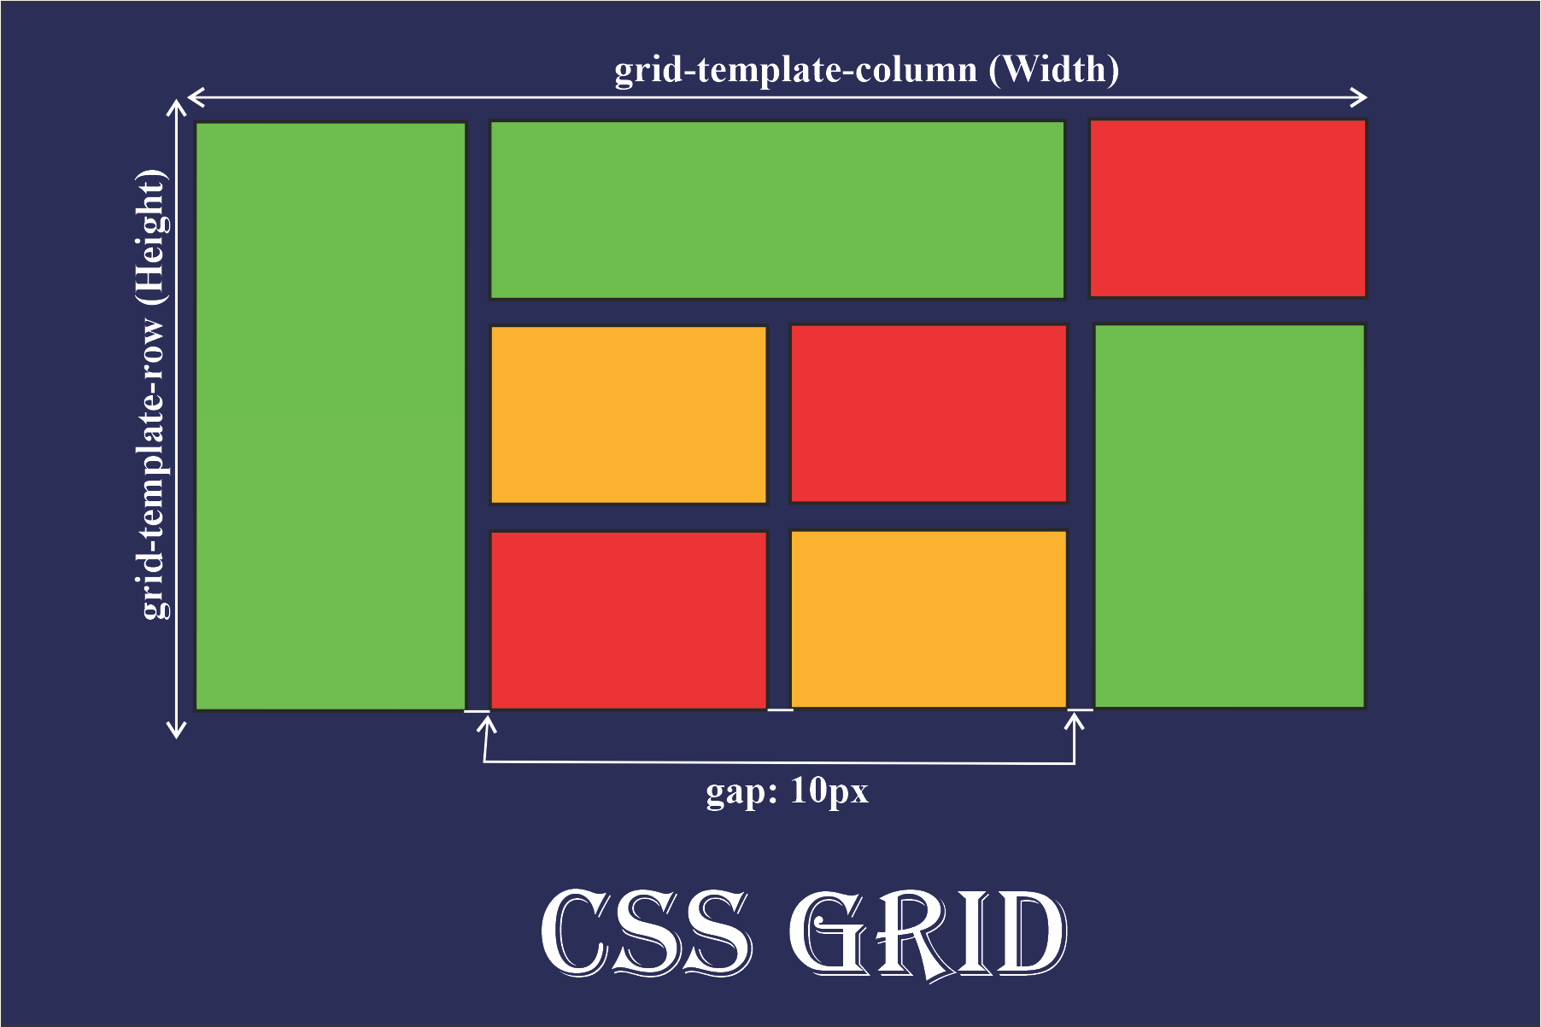
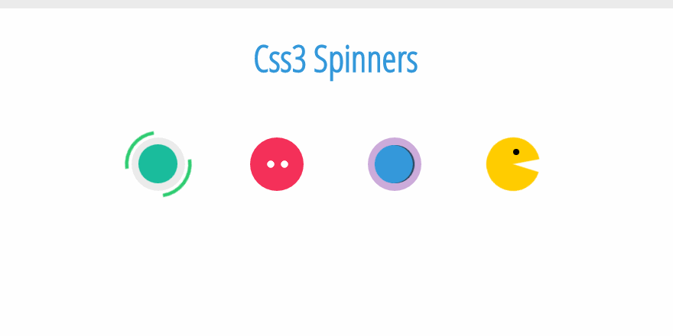
More exciting CSS
Flexbox – 1D layout
CSS grid – 2d layout
CSS animations

Slide 11
JS basics
A programming language! Closest to C:
Let x = 5; or var x = 5; const y = 10;
function doSomething (x) {
return x + 3;
}
for (let i = 0; i < items.length; i++) { ...

Slide 12
JS: DOM Elements
Javascript allows us to manipulate the DOM. To do so, we need to get DOM objects:
.getElementById document.getElementById(‘main-p’)
.querySelector document.querySelector(‘.item’)
.querySelectorAll document.querySelectorAll(‘.item’)
.parentElement button.parentElement

Slide 13
JS: Manipulating DOM Elements
Javascript allows us to manipulate the DOM. To do so, we need to get DOM objects:
.createElement let p = document.createElement(‘p’);
.innerHTML p.innerHTML(‘New paragraph!’)
.style p.style.backgroundColor = “green”;
Q: What would display on a page with this code in a <script>

Slide 14
JS: Event Listeners
<DOM_ELT>. addEventListener(<event>, <fun>)
This creates an ‘event listener’ attached to this DOM element, every time <event> is detected at this element, it executes <fun>.
button.addEventListener(‘click’, function() {alert(‘clicked!’)})

Slide 15
JS: Event Listeners
button.addEventListener(‘click’, function() {alert(‘clicked!’)})
Anonymous functions:
When we don’t need to re-use a function
Function not bound to an ‘identifier’ (name!)

Slide 16
JS: Event Listeners
button.addEventListener(‘click’, function() {alert(‘clicked!’)})
----------------------------------------
function handleAlert() {
alert(“Loaded!");
}
document.addEventListener(‘DOMContentLoaded', handleAlert);

Slide 17
Javascript demo

Slide 18


Lab problem:
https://cs50.harvard.edu/college/2022/fall/labs/8/

Slide 19
PSET 8 pointers
Homepage:
Meet all the criteria!
Use the internet!
Inspect element pages to see how others have done things that you like. Youtube tutorials also great!
Ideas: portfolio website, website for each of your hobbies, basic sketch-up of a website you like, anything!

Slide 20

Cya next week :D

